Slide 1
Topic: Negotiation
Dr. C. Vijaya Banu
Professor , School of Management
SASTRA Deemed University, Thanjavur – 613 401
vijayabanu@mba.sastra.edu

Slide 2
INTRODUCTION
Negotiation is the process of bargaining, Where two parties, trying to reach an agreement on mutually accepted terms to acquire each others wants.
Example:
Customer trying to negotiate with buyer over a price of a product.
Negotiation for salary between employee & employer.

Slide 3
DEFINITIONS OF NEGOTIATION
Rubin and Brown (1975)
Negotiation refers to a process in which individuals work together to formulate agreements about the issues in dispute. This process assumes that the parties involved are willing to communicate and to generate offers, counteroffers, or both. Agreement occurs if and only if the offers made are accepted by both of the parties.

Slide 4
DEFINITIONS OF NEGOTIATION
In the words of Bill Scott ,” a negotiation is a form of meeting between two parties: OUR PARTIES & OTHER PARTIES”.
According to J.A. Wall, ”negotiation is a process in which two or more parties exchange goods or services and attempt to agree on the exchange rate for them.”
Winston’s Advanced Dictionary,”the discussions & bargaining that goes on between parties before a contract is settled or deal is agreed upon”.

Slide 5
NATURE OF NEGOTIATION
It requires involvement of two parties.
Requires flexibility.
A process not an event.
Needs effective communication.
Continuous process( i.e. between buyer & seller, employer & employee for wages, working hours etc)
Win- win situation for parties involved.

Slide 6
P’s OF NEGOTIATION
Like P’s of Marketing, essentials of negotiation are called as P’s of negotiation. They are as follows:
Purpose : aim is required otherwise it will result in wastage of money, manpower & time.
Plan : main agenda on which negotiation is to be carried on.
Pace : main points should be covered in discussions, also proper breaks must be introduced to maintain interest of peoples involved.
Personalities : negotiator initiating negotiation must have convincing power, effective communication skills, can influence people & process of negotiation

Slide 7
FACTORS AFFECTING NEGOTIATION
PLACE: Familiarity with surrounding helps in boosting confidence.
TIME: Time should be adequate for smooth exchange of ideas & securing agreement before it is to late .
ATTITUDE: Attitude of both parties should be positive, i . e, willingness to make an agreement or deal.
SUBJECTIVE FACTORS: Like relation of two parties involved, status difference, information & expertise.

Slide 8
Negotiation Strategies
Distributive Negotiation
The most distributive feature is that it operates under a zero sum game, that the gain made by one person is loss incurred by the other person.
Each person involved in the negotiation defines ultimate point where the settlement will be made.
Integrative Negotiation
The characteristic feature of integrative bargaining is that it relies in win-win situation and therefore uses a collaborative model of conflict resolution.
Both parties involved in negotiation process jointly look at the problem, try to search for alternatives and try to evaluate them and reach a mutually acceptable decision or solution.

Slide 9
Negotiation Strategies
Distributive Negotiation (Competitive Tactics)
Strategies used in it are
I want it all
Time wrap
Challenge
Integrative Negotiation (Cooperative Tactics)
Strategies used in it are
Focus on interests and not position
Separate the people from the problem
Insist on using objective criteria
Invest option for mutual gains

Slide 10
Distributive vs Integrative Bargaining
Bargaining Characteristic | Distributive Bargaining | Integrative Bargaining
Goal | Get as much of the pie as possible | Expand the pie so that both parties are satisfied
Motivation | Win–lose | Win–win
Focus | Positions (“I can’t go beyond this point on this issue.”) | Interests (“Can you explain why this issue is so important to you?”)
Interests | Opposed | Congruent
Information sharing | Low (Sharing information will only allow other party to take advantage) | High (Sharing information will allow each party to find ways to satisfy interests of each party)
Duration of relationship | Short term | Long term

Slide 11
Bargaining Zone
The bargaining zone is the area where each side’s bargaining range overlaps, and is the area in which agreement is possible.
Your Bargaining Zone is the range or area in which an agreement is satisfactory to both negotiating parties.
Through the bargaining process, negotiators for each side need to determine the other’s party’s likely bargaining range, whether the ranges overlap, and if so, how best to maximize a settlement for their party within the bargaining zone.
For example, management’s bargaining range for a wage increase is 1% to 6%. The union’s range is 4% to 10%. So the bargaining zone is between 4% and 6%.

Slide 12
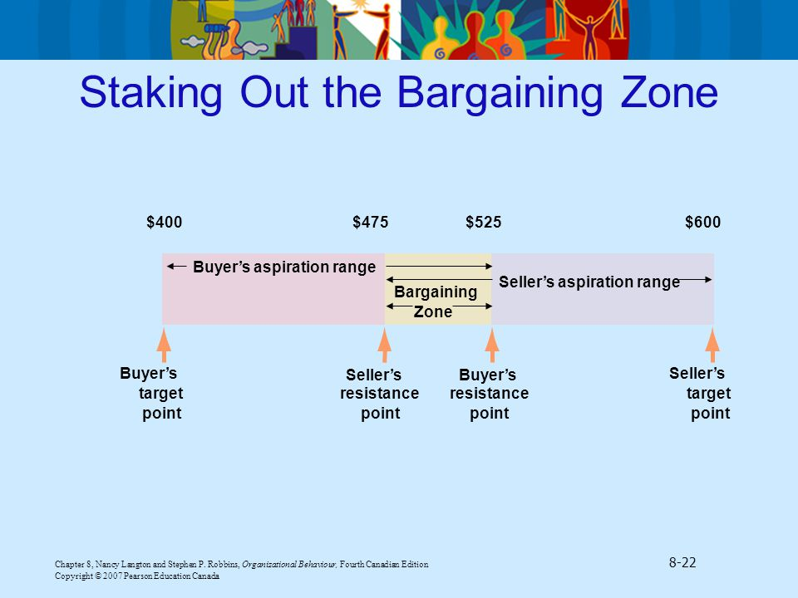
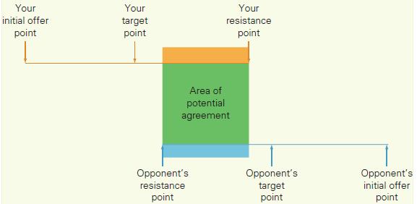
Staking Out the Bargaining Zone

Slide 13
Importance of Negotiation
Certainty
The aim of contract negotiation is firstly to achieve certainty, to record what is being supplied, when, in what quantities and to what standard, and what are the consequences of delay or failure to meet the agreed requirements.
The best deal
Seeking clarity does not conflict with the view that negotiations should achieve the best deal, it merely points out that both parties to a negotiation have to understand what it is that they have agreed to.

Slide 14
Importance of Negotiation
Achievement of an Organization's Objectives
The goal of every negotiation must be to achieve a result which, even if it falls short of the original objective, can be considered a satisfactory advancement towards it.
Create of a long-term relationship between the parties
Whilst this is not always possible, and some cultures, such as the Japanese, place more emphasis on this aspect of negotiation, this is increasingly important as companies build networks of alliance partners.

Slide 15
Negotiation Process
Negotiation is a method by which people settle differences.
It is a process by which compromise or agreement is reached while avoiding argument and dispute.
In order to achieve a desirable outcome, it may be useful to follow a structured approach to negotiation.

Slide 16
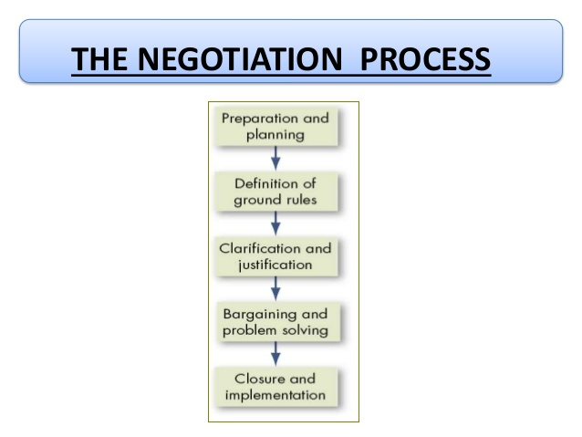
Negotiation 5 Step Process

Slide 17
Negotiation Process
Preparation and planning:
Before starting negotiation, one needs to find out the parties involved in negotiation & goals of the negotiation.
Your Position
Interests and why you value them
Strengths and Weaknesses
Other Party’s Position
Goals
Demands
Hidden Interests

Slide 18
Definition of ground rules:
After completion of planning and developed a strategy, the ground rules and procedures with the other party over the negotiation itself should be defined.
Lay down Rules and Regulations
Who will negotiate?
Place?
Constraints?

Slide 19
Negotiation Process
Clarification & justification: When initial positions have been exchanged, both the party will explain, amplify, clarify, bolster (to hold up) and justify each other's original demands.
It is an opportunity for educating and informing each other or the issues, why they are important and how each arrived at their initial demands.

Slide 20
Negotiation Process
Bargaining & problem solving:
The essence of the negotiation process is the actual give and take in trying to hash out an agreement.
Concessions will undoubtedly need to be made by both parties.
Closure & Implementation:
The final step in the negotiation process is formalizing the agreement that has been worked out and developing any procedures that are necessary for implementation and monitoring (handshake).
Get the Specifics written in a formal contract, if necessary.

Slide 21
Roles and Function of Third Party Negotiations (Conflict Resolution)
Negotiating is a Social Context:
Reputation:
the way other people think and talk about you.
Develop a trustworthy reputation – competence and integrity.
Relationships:
think about what’s best for the other party and the relationship as a whole.
Repeated negotiations built on trust provide more options

Slide 22
When individuals or group representatives reach a stalemate and unable to resolve their differences through direct negotiations, they may turn to a third party.
A Mediator
A neutral third party who facilitates a negotiated solution by using reasoning, persuasion, and suggestions for alternatives.
Mediation means the process in which a neutral (means not supporting any one side) third party assists the parties in conflict to reach a solution. The third party is called the mediator and the mediator facilitates communication between the parties. ... They assist in each party to understand the other party's interests.
An arbitrator
A third party to a negotiation who has the authority to dictate an agreement.
An conciliator
A trusted third party who provides an informal communication link between the negotiator and the opponent.
Conciliation is an alternative out-of-court dispute resolution instrument. Like mediation, conciliation is a voluntary, flexible, confidential, and interest based process. The parties seek to reach an amicable dispute settlement with the assistance of the conciliator, who acts as a neutral third party

Slide 23
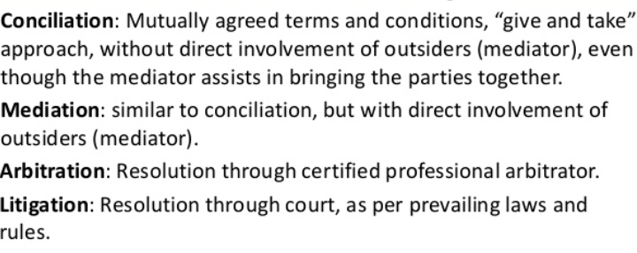
Mediation and conciliation both are an informal process. Whereas, arbitration is more formal as compared to them. ... Dispute resolution through conciliation involves the assistance of a neutral third party who plays an advisory role in reaching an agreement.

Slide 24
SEVEN ELEMENTS OF EFFECTIVE NEGOTIATIONS
Relationship
Communication
Interests
Options
Alternatives
Legitimacy
Commitment

Slide 25
Relationships
Am I Prepared To Deal With The Relationship?
a) A good negotiating relationship is needed to address differences and conflicts.
b) Separate people issues from substantive issues.
c) Plan and prepare to build and maintain a good working relationship.
d) Be respectful, trustworthy and unconditional constructive.

Slide 26
Communication
Am I Ready To Listen And Talk Effectively? Creating A Learning Conversation
a) Core Skills – Basic Communication Skills in Negotiation
Active listening
Acknowledging what has been said and felt
Speak for a purpose
b) Core Skills – Communications to Gather Knowledge and Learn About Their Interests
Clarifying and Probing Skills
Integrative Framing Skills
Paraphrasing
Summarising

Slide 27
INTERESTS
WHAT DO PEOPLE REALLY WANT?
Collectively identify and articulate the interests, concerns, and needs of all relevant parties (mine, yours, theirs)
Identify and prioritize community interests together. Get on the same page.
Probe for your and their unarticulated or underlying interests
Share and clarify the respective interests of the parties. Move beyond speculation about to acknowledgement of their interests.
Identify and share common interests as a basis to develop options.
Interests from the agenda.

Slide 28
OPTIONS
WHAT ARE THE POSSIBLE AGREEMENTS OR BITS OF AN AGREEMENT?
Design options, not positions.
Create options to meet interests of both parties.
Remember when designing options they also must transparently meet their interests. Find ways to maximize joint gains for both.

Slide 29
ALTERNATIVES
WHAT WILL I DO IF WE DO NOT AGREE?
Do we need to negotiate or can we satisfactorily meet our interests in other ways?
Identify and articulate our best/doable alternatives to a negotiated agreement.
Fully understand the implication, consequences, risks and costs of your and their BATNA.
Select and improve our BATNA
Identify the best and worst alternatives open to the other side.

Slide 30
LEGITIMACY
WHAT CRITERIA WILL I USE TO PERSUADE EACH OF US THAT WE ARE NOT BEING RIPPED OFF?
Fairness is a governing consideration.
Use external criteria and objective standards as a basis to legitimize your preferred options and as a shield against unreasonable proposals from the other side.
Use demonstrable “fairness” of the process and outcome to persuade them of the merits of a proposal.
Offer their negotiator an attractive way to explain his decision to his principals.

Slide 31
COMMITMENT
WHAT COMMITMENTS SHOULD I SEEK OR MAKE?
Get commitments at the end not the beginning.
Identify all of the implementation issues to be included in the agreement. No post argument surprises?
Plan the timeframe and steps to implement the agreement.

